Slide 1


Slide 2

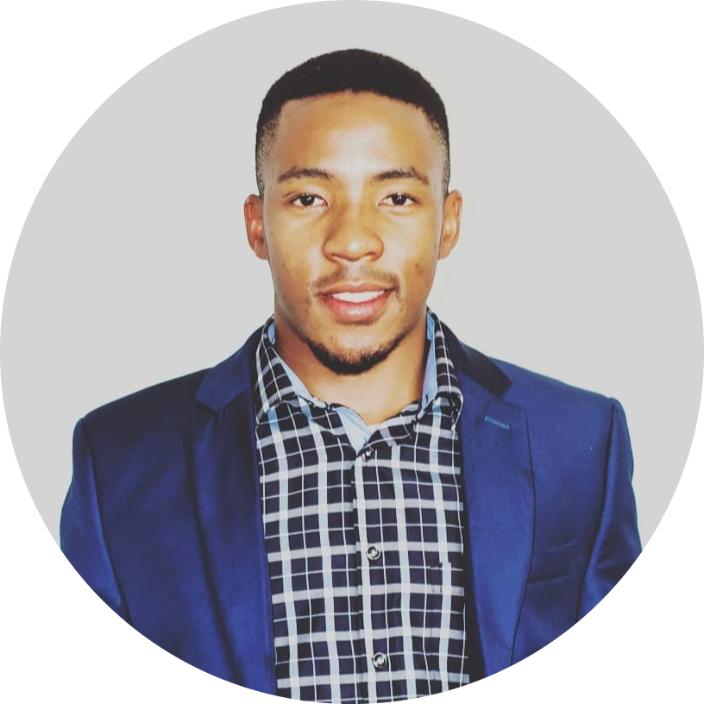
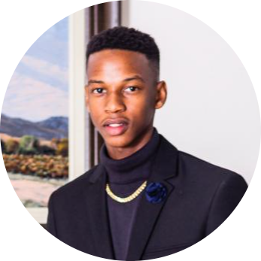


OUR TEAM
Reloef Khoza CEO
Gabriel Maja CEO
Boipelo Morokolo Managing Director Research & Development
Ruth Mahlako CTO
Ofhani Mukwevho Managing Director

Slide 3
table of contents
01
02
03
Project Brief
MARKET ANALYSIS
Building Model
04
05
06
Application demo
Business case
Conclusion
Specifications and objectives
Research & gather data on climate change -Twitter
Analysing of models
Run through of the App
The system built has capacity to bring impact.
We have brought your company what you need!

Slide 4
Project BRief
01

Slide 5



Background
Achieve carbon
neutrality by 2050
Attain Zero emission
from our vehicles
Use 100 percent local,
renewable energy

Slide 6
02
MARKET ANALYSIS
AND COMPETITION

Slide 7

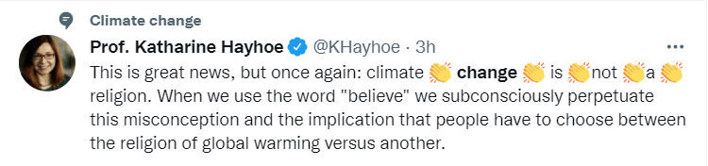
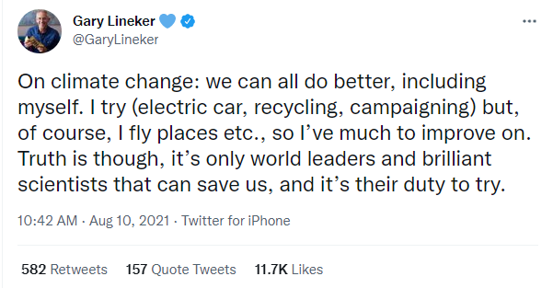
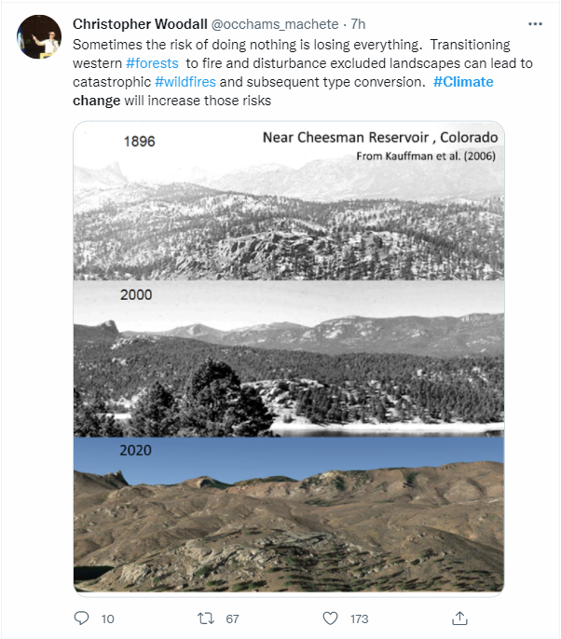
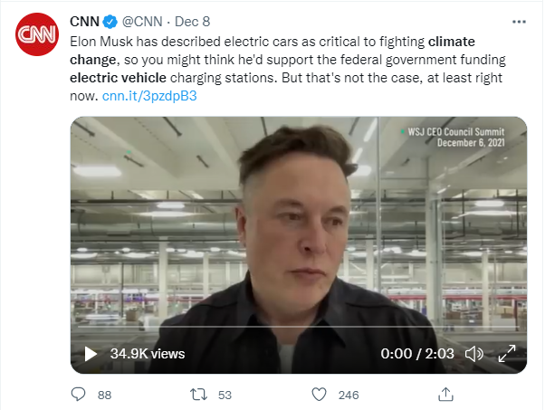
Data key source

Slide 8
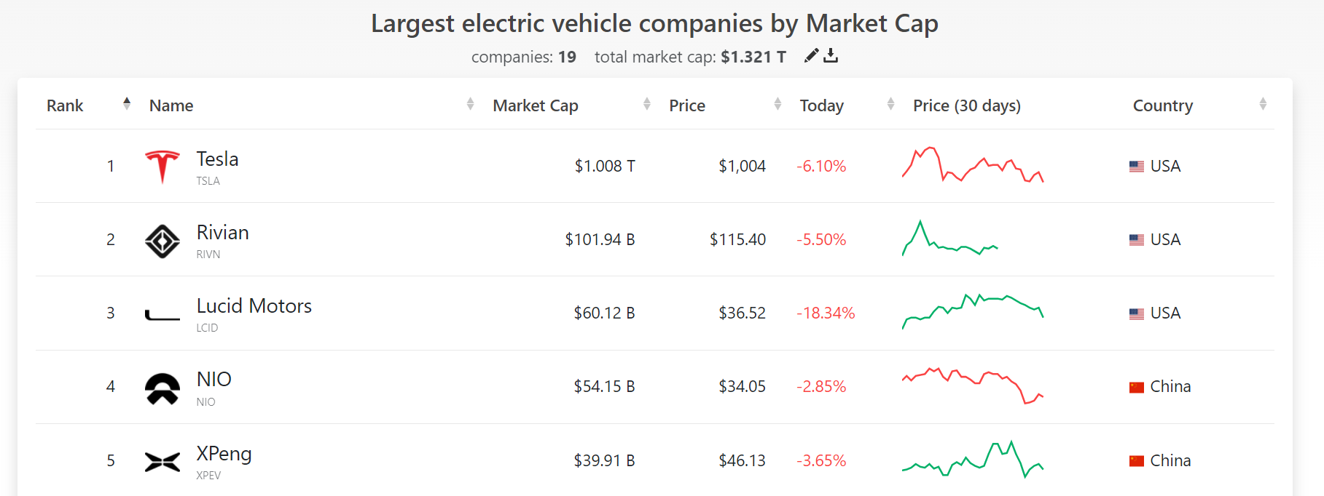
Competition in the market

Slide 9
Models
03
Building

Slide 10
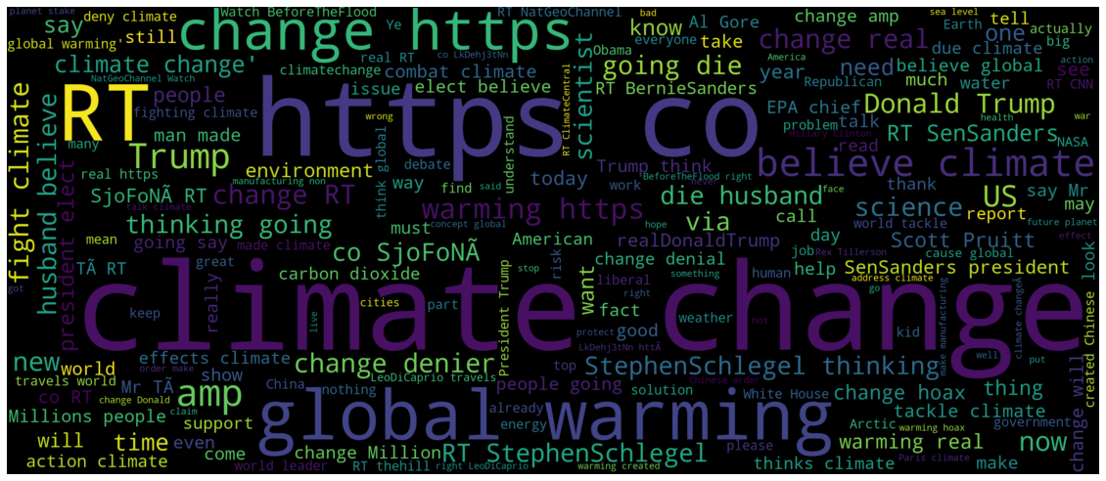
Word cloud of Most frequent words

Slide 11
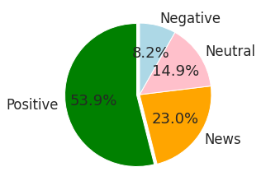
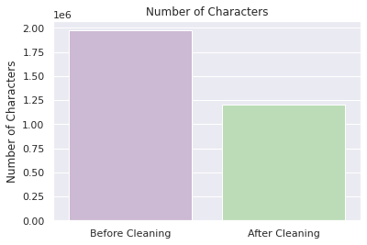
Tweets Numerical Distribution
Number of characters bar-Graph

Slide 12
Model comparison based on f1 scores
MODELS | F1 SCORES | DURATION
LINEAR SVC | 0.74 | 1hr 27min
STACK CLASSIFIER | 0.74 | 9hrs
SVC LINEAR KERNEL | 0.73 | 1 hr 30 min
SVC RADIA KERNEL | 0.70 | 1 hr 30 min
GRADIENT BOOST | 0.60 | 1 hr 30 min
ADA BOOST MERTICS | 0.60 | 1 hr 30 min
DECISION TREE | 0.61 | 1 hr 29 min
RANDOM FOREST | 0.69 | 1 hr 32 min

Slide 13
Application
04
Demo

Slide 14
business
05
case

Slide 15
Linear svc model product
Stack classifier product

Slide 16
Defining your future today

Slide 17

THANKS!
Do you have any questions?

